Slide 1
The Holocaust: Images & Political Messaging
Is Anti-Semitism Dead?

Slide 2
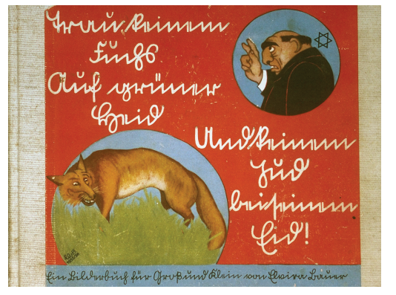
Image #1
When and where do you think this is from?
The origin:
1936, a children’s book cover, for the propaganda book “Trust no fox in the green meadow and no Jew on His Oath”

Slide 3
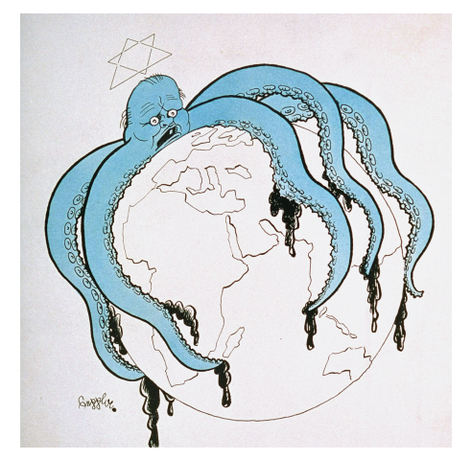
Image #2
When and where do you think this is from?
The origin:
1938, a political Cartoon by Josef Plank (a.k.a. Seppla) showing the “global Jewish conspiracy” personified as an octopus

Slide 4
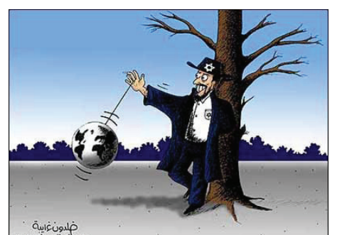
Image #3
When and where do you think this is from?
The origin:
This one is actually from the 2000s! It is attributed to www.ghareibeh.org, and shows the “world on the string” of the Jews.

Slide 5
Image #4
When and where do you think this is from?
The origin:
This one is actually from the modern United States! It is in the style of Jack Chick, an infamous social-conservative political cartoonist.

