Slide 1
The Holocaust: The Background
Causes

Slide 2
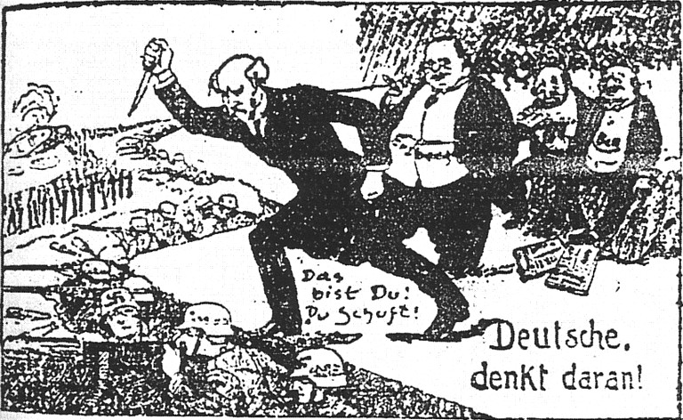
The Dolchstosslegende
The man with the knife is Phillipp Scheidemann, the politician who proclaimed the Weimar Republic.
“Deutsche, denkt daran!” = “Germans, think about this!”
“Das bist Du! Du Schuft!” = “That is you! You villain!”
Who is Scheidemann stabbing?

Slide 3
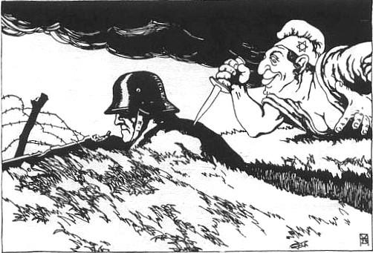
The Dolchstosslegende
The man, a WWI soldier, is being attacked by a Jewish woman - note the Star of David.
How could the Jews be to blame for the end of WWI not being in Germany’s favor?

Slide 4
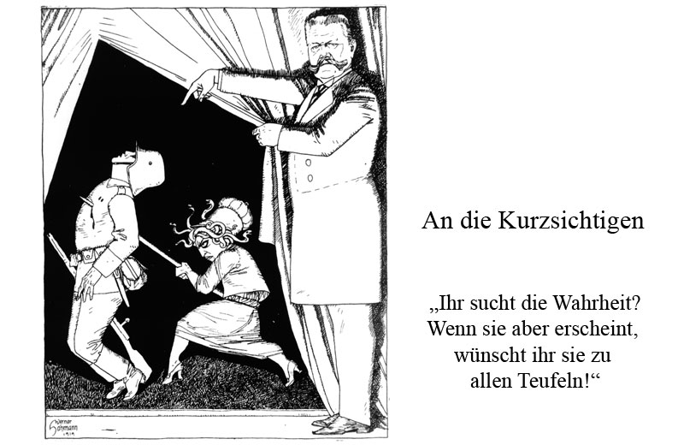
The Dolchstosslegende
Translation:
To the Myopic
“You seek the truth? But if she appears, you wish her to all the devils.”
The man holding the curtain is Hindenburg.

Slide 5
The election activity: who voted for which party?
Hermann Struts: SPD, KPD, or Nazi?
Otto Hauptmann: SPD, KPD, or Nazi?
Eric von Ronheim: SPD, KPD, or Nazi?
Karl Schmidt: SPD, KPD, or Nazi?
Wilhelm Schultz: SPD, KPD, or Nazi?
Elisabeth von Kohler: SPD, KPD, or Nazi?
Gerda Munchen: SPD, KPD, or Nazi?
Hermann Struts: Nazi
Otto Hauptmann: ?
Eric von Ronheim: Nazi
Karl Schmidt: ?
Wilhelm Schultz: Nazi
Elisabeth von Kohler: ?
Gerda Munchen: Nazi

Slide 6
Stages of the Holocaust
What did the Nuremberg Laws do?
They regulated the rights of Jewish people in Germany. The Jews were no longer full citizens.
What makes this a sign that a genocide may occur soon? How does it remind you of Armenia?
Stage One: Nuremberg Laws
The Armenians had an official second class status as “infidels” in the Ottoman Empire. It’s a short step from second class to enemy.

Slide 7
Stages of the Holocaust
What happened on Kristallnacht? When was it?
Jewish homes, synagogues, and businesses were vandalized and destroyed. It happened on November 9th, 1938.
What makes this a sign that a genocide may occur soon? How does it remind you of Armenia?
Stage Two: Kristallnacht
(literally “Crystal Night”, it has been translated as “The Night of Broken Glass”.)
Kristallnacht marks a transition from nonviolent to violent treatment of Jews. To have a genocide, discrimination must eventually become violent.

Slide 8
Stages of the Holocaust
What is a ghetto? Where were they?
The ghettos were sealed-off neighborhoods in cities where the Jews had to live/stay. Ghettos existed in cities in occupied territory - as far south as Greece, and as far east as Ukraine - but the majority were in Poland.
What makes this a sign that a genocide may occur soon? How does it remind you of Armenia?
Stage Three: Ghettos
When a minority is physically isolated from the rest of the citizens, it’s easier to commit genocide against the members. Armenians were isolated in the process of deportation.

Slide 9
Stages of the Holocaust
What is a concentration camp? Where were they?
The concentration camps were essentially holding pens for the Jews and other removed groups, in which the healthy were put to hard labor. Most concentration camps were scattered throughout Germany.
What makes this a sign that a genocide may occur soon? How does it remind you of Armenia?
Stage Four: Concentration Camps
Much like the ghettos, this is another, firmer step towards dehumanizing and isolating the Jews.

Slide 10
Stages of the Holocaust
What is “the Final Solution”?
Eventually, the German leadership decided to exterminate the Jewish population, and did so by emptying the ghettos - and having the surviving Jews of the ghettos and concentration camps sent to death camps, where execution was swift if not merciful (ex. Gas chambers). Unlike their predecessors, death camps were mostly in Poland.
Stage Five: Death Camps;
“The Final Solution”
How does it remind you of Armenia?
Once again, the government becomes impatient and decides to finish what they have started with a killing spree.

Slide 11
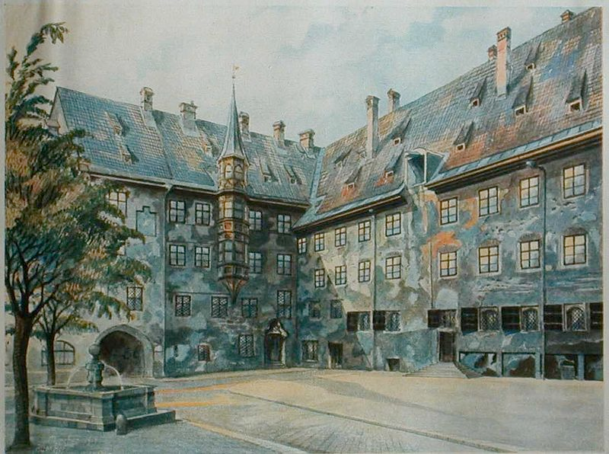
Maybe Hitler should have stayed an artist...
The Courtyard of the Old Residency in Munich, Adolf Hitler, 1914

Slide 12
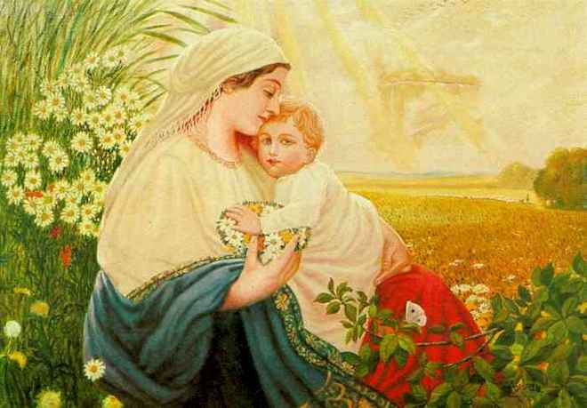
Videos: courtesy of the U.S. Holocaust Memorial Museum
Hitler's Campaign speech
Einsatzgruppen
Another Hitler painting: Mother Mary with the Holy Child Jesus Christ

Slide 13
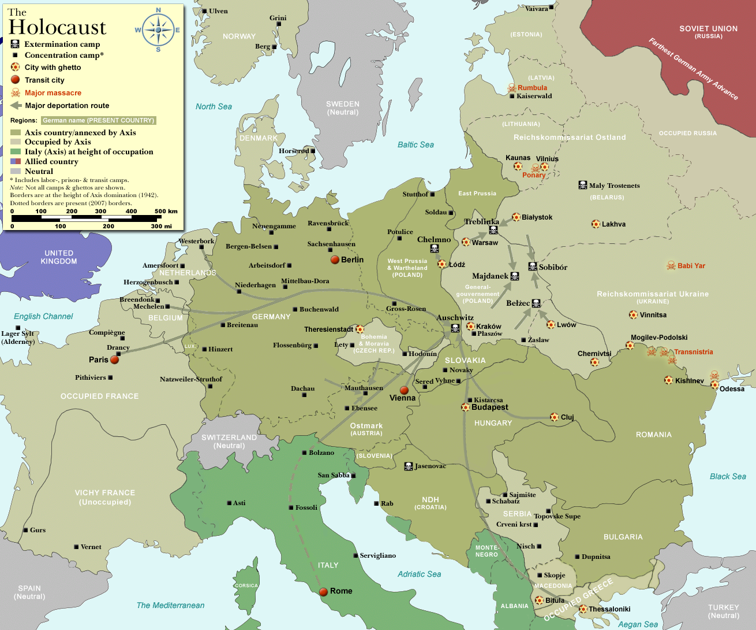
Map: Camps, Ghettos, Deportation Routes
Notes:
Thanks to Dennis Nilsson.

Slide 14
Finding the GIST
Read/listen to/watch a source.
Take notes on the 5W and H:
Who
What
When
Where
Why
How
Pick out the twenty most important words that, if you had to summarize the source as quickly as possible, you would use.
Assignment:
Go to "Some Were Neighbors" at http://somewereneighbors.ushmm.org/#/exhibitions
Read/listen to/watch the sources in the category you are assigned
Take down the GIST for each one. You should be able, after 20-30 minutes, to tell the rest of the class about the sources in clear summaries.

