Slide 1
The Holocaust
A Photographic Slideshow

Slide 2
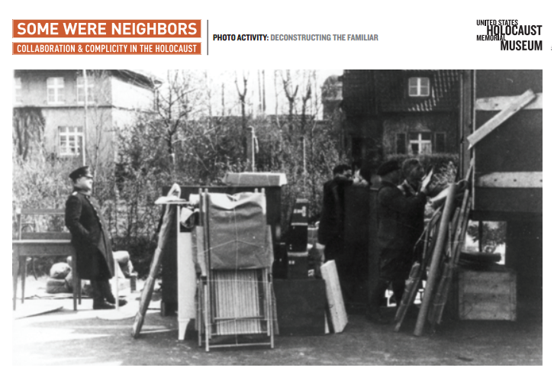
The Truth Behind the Photos
What do you think is going on in this photo?

Slide 3
The Truth Behind the Photos
Caption:
German customs officials supervise the packing of a moving van containing the belongings of a Jewish family preparing to emigrate. Part of the officials’ job was to prevent the smuggling of valuables that law prohibited Jews from taking with them.
Bielefeld, Germany, 1936. Stadtarchiv Bielefeld

Slide 4
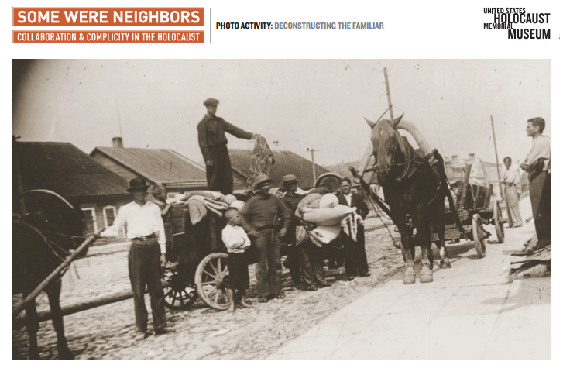
The Truth Behind the Photos
What do you think is going on in this photo?

Slide 5
The Truth Behind the Photos
Caption:
A member of the Lithuanian auxiliary police auctions off property of Jews who were recently executed in the nearby Rase Forest.
Lithuania, July–August 1941. US Holocaust Memorial Museum, courtesy of Saulius Berzinis

Slide 6
The Truth Behind the Photos
What do you think is going on in this photo?

Slide 7
The Truth Behind the Photos
Caption:
A police offi cial distributes Jewish badges after German occupation orders require Jews residing in the northern occupied zone of France to wear badges.
Paris, 1942. Nationaal Archief/Spaarnestad Photo/Cl. Aveline

Slide 8
The Truth Behind the Photos
What do you think is going on in this photo?

Slide 9
The Truth Behind the Photos
Caption:
SS officers and female assistants at an SS resort 18 miles from Auschwitz. Many of those depicted were involved in processing the Jewish deportees who arrived at Auschwitz from Hungary in summer 1944.
July 1944. US Holocaust Memorial Museum

Slide 10
The Truth Behind the Photos
What do you think is going on in this photo?

Slide 11
The Truth Behind the Photos
Caption:
An anti-Jewish banner hangs over a busy, commercial street in Treptow, Germany. The banner reads: “The Jews are our misfortune.”
Stadtarchiv Nürnberg, Stürmer Archiv, E39 Nr.2261/4

Slide 12
The Truth Behind the Photos
What do you think is going on in this photo?

Slide 13
The Truth Behind the Photos
Caption:
Jews from an area of Greece recently occupied by Bulgaria, an ally of Nazi Germany, register with Bulgarian officials for deportation to the Treblinka killing center.
Lom, Bulgaria, March 1943. Photographic Archive of the Jewish Museum of Greece

Slide 14
The Truth Behind the Photos
What do you think is going on in this photo?

Slide 15
The Truth Behind the Photos
Caption:
Uniformed Gestapo officials load Jews onto trucks for deportation in full view of many onlookers.
Kerpen, Germany, 1942. Stadtarchiv Kerpen

