Slide 1
The Cambodian Genocide
Perpetrators and U.S. Involvement

Slide 2
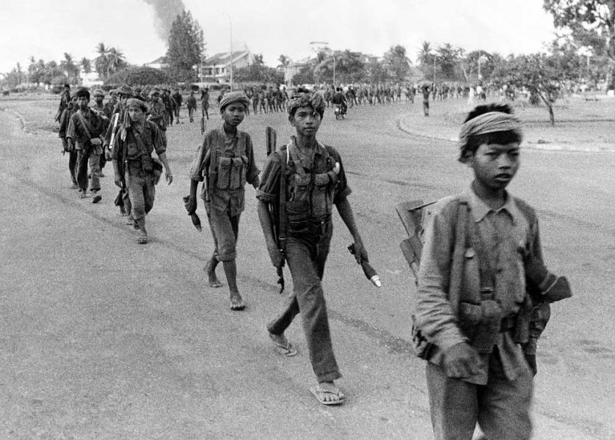
What do we know about Khmer Rouge fighters?
Often young men, but not exclusively so
Often peasants, ditto
Often uneducated, ditto
After the genocide is over, they must grapple with their guilt by themselves. We see in the film clips from “Enemies of the People” that some Khmer Rouge are more able to accept blame than others.

Slide 3
What do we know about Khmer Rouge leaders?
We already know about Pol Pot, the head of the Khmer Rouge. During the period of the genocide, he takes the title “Vach du Mach” or “One with the Gun”.
“Comrade Duch”: the head of internal security, and the overseer of the Tuol Sleng prison, where thousands were tortured and executed.
“Brother Number 2”: His real name, Nuon Chea, was used less often, as his title indicated how he was second in command to Pol Pot. Hypocritically, he was part ethnic Chinese himself.
Ieng Thirith: Pol Pot’s sister-in-law, she was likely involved in planning, and certainly set the Khmer Rouge on specific targets for extermination.

Slide 4
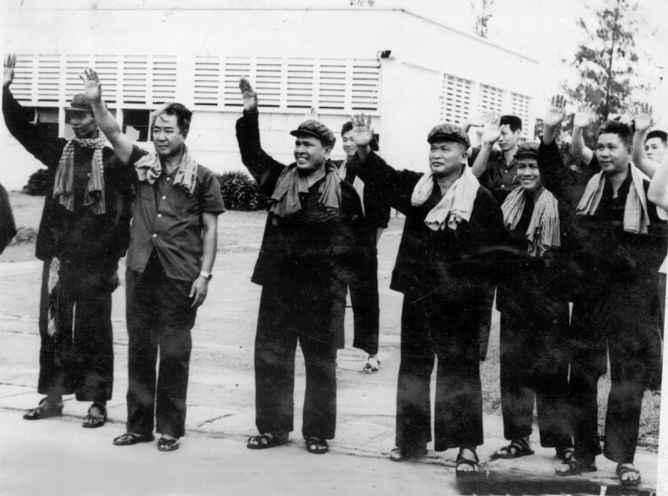
The Khmer Leaders

Slide 5
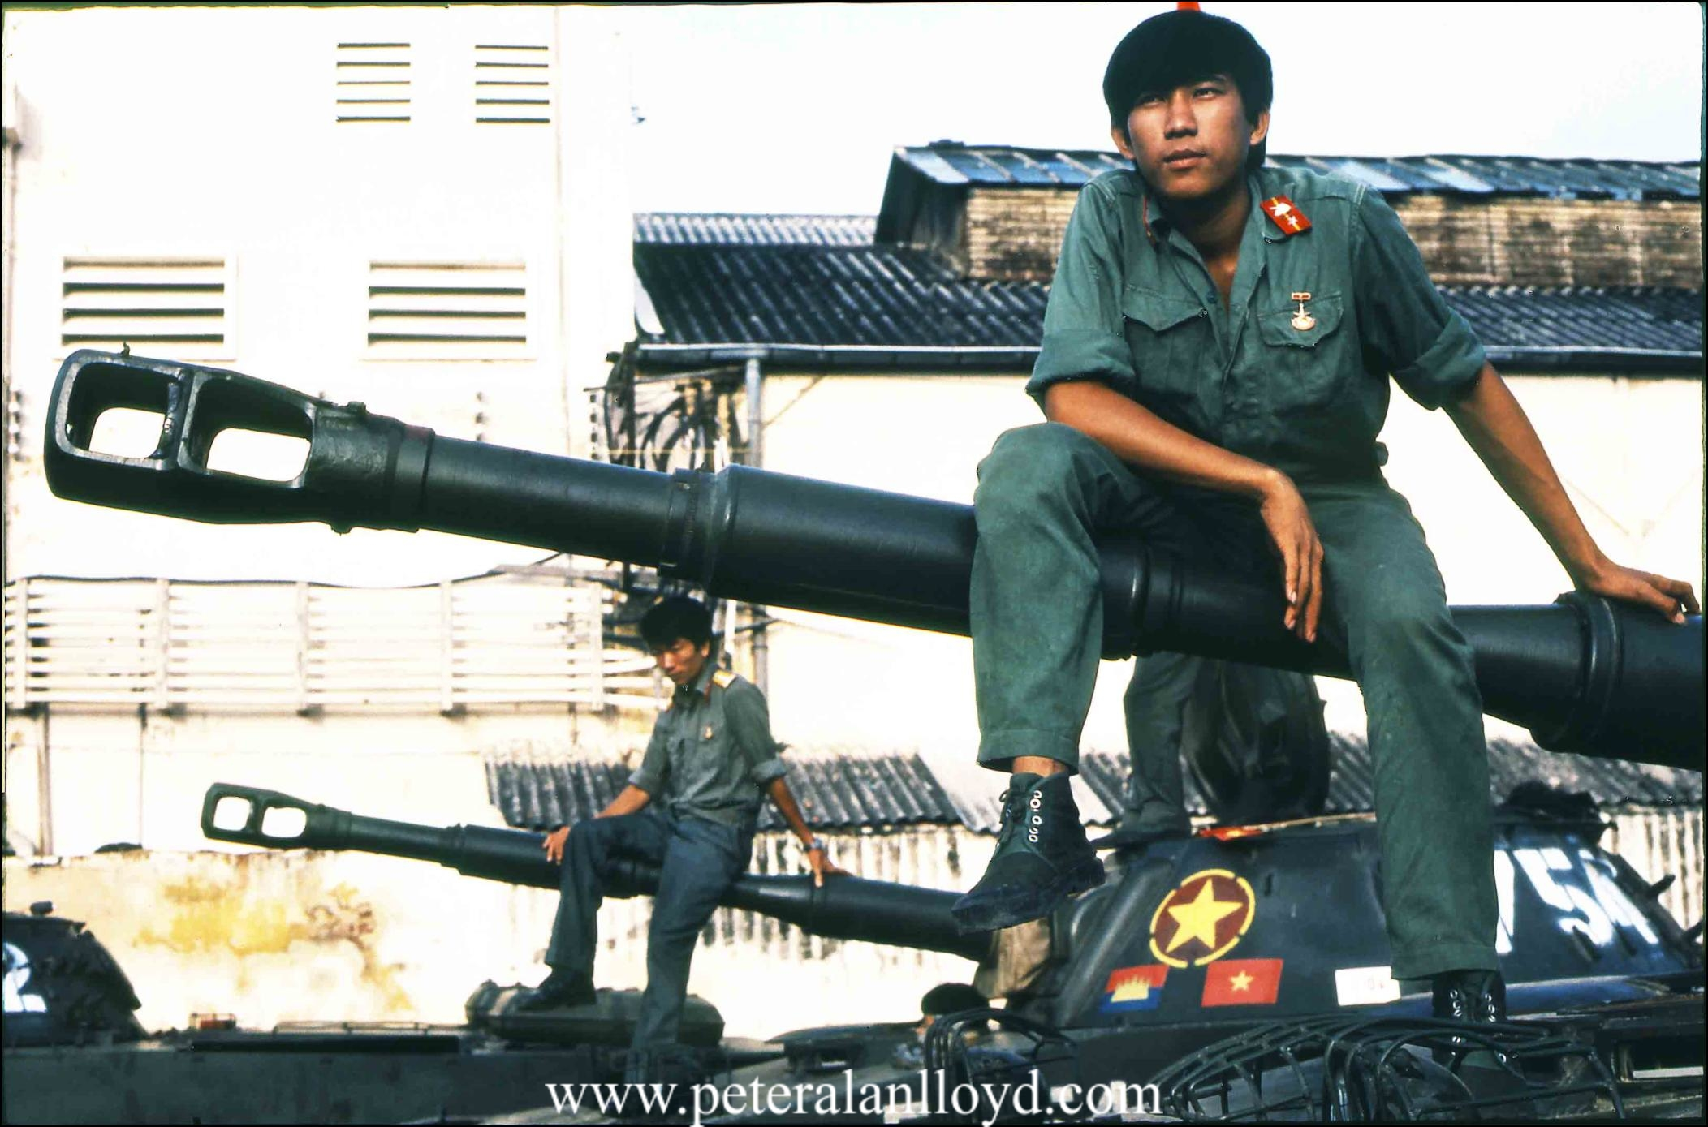
What event(s) ended the genocide?
1978-79: The Vietnamese invade Cambodia again. The Khmer Rouge are driven out of power, and Vietnam occupies Cambodia for over a decade.
Cambodia, in response to this occupation, undergoes a 13-year civil war. Some Cambodians flee to Thailand, and others to the U.S.

Slide 6
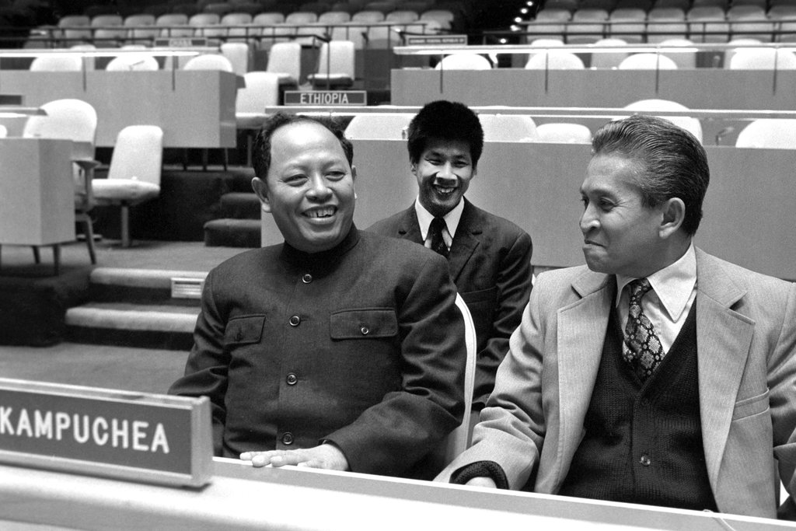
What does the United States think of this?
Well… remember how the U.S. kept changing who it supported, based on whether they opposed Vietnam? That habit doesn’t change!
The U.S. supports the Khmer Rouge even when they are reduced to hiding in the jungles again.
The U.S. even helps the Khmer Rouge keep their seat in the United Nations - implying that they are the legitimate leaders of Cambodia.

Slide 7
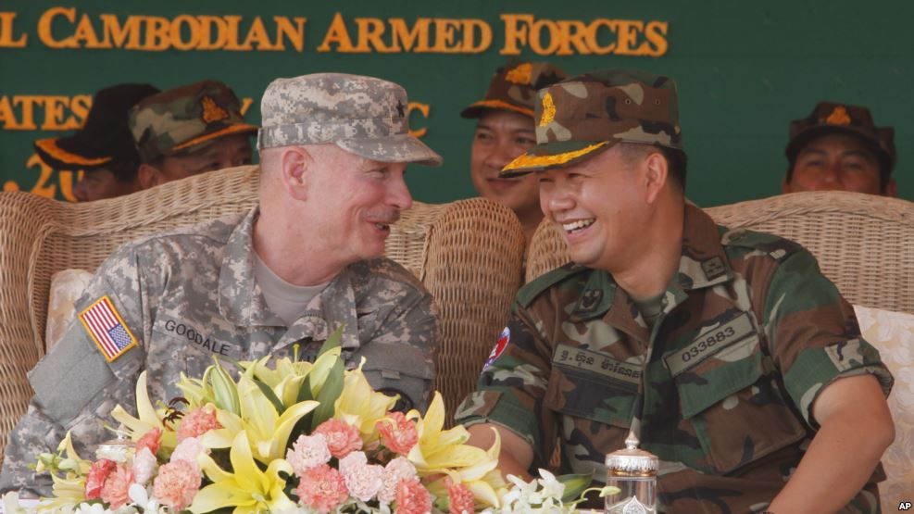
What does the United States think of this?
Under Presidents Ford and Carter, in the 1970s the U.S. gives millions of dollars to the Khmer Rouge (and to Sihanouk, still their ally), and in turn issues a trade embargo against the Vietnam-backed official Cambodian government.
Why? Because we still distrust the communist Vietnamese, and they are now backed by the Soviet Union...

Slide 8
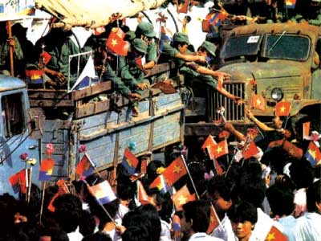
What happened next?
1991: a Paris peace agreement officially ends the war. 2 years later, the United Nations assists in democratic elections.
Our old friend, King Sihanouk, takes power again - but his new Prime Minister, Hun Sen, is a former general for the Khmer Rouge.
The last of the Khmer Rouge are captured in 1999. The movement is over.

Slide 9
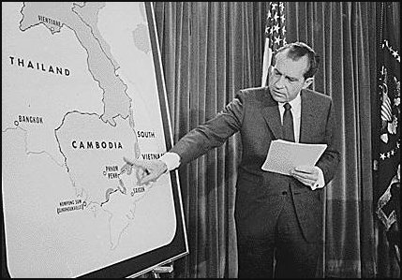
EXIT TICKET
Answer the following questions and hand them in before leaving:
Who were some of the leaders of the Khmer Rouge? Name them, and describe what they did.
What happened in 1978?
Who did the U.S. support, and why?
What happens in the 1990s?

