Slide 1
The Cambodian Genocide
Justice… or just us?

Slide 2
What about genocide denial?
Denial started to disappear when, in the early 1980s, the Vietnamese started to dig up the killing fields. By the 1990s denial was no longer common in the U.S.
In 2013, Cambodia’s Hun Sen (that same old Khmer Rouge general) approved a bill making genocide denial illegal. He’d previously suggested that Cambodia should “dig a hole and bury the past”.
The U.S. had been in some denial during the 1970s and 1980s that what had happened was at the level of genocide.
U.S. scholars argued that autogenocide, or the destruction of a group by members of that group (in this case, Cambodians), was unlikely to happen in the modern world. If genocide really occurred, they supposed that it was the occupying Vietnamese who did it.

Slide 3
What about genocide denial?
In 2002, Amanda Pike was sponsored by PBS and went to Cambodia in an effort to interview citizens and former Khmer Rouge leaders.
Remember, at this point no trials have taken place or even been scheduled.

Slide 4
When does the wheel of justice start turning?
Decades later, the UN agrees that what happened in Cambodia should be classified as a genocide.
In 1994, President Clinton signals a change in U.S. policy, when he signs off on the “Cambodian Genocide Justice Act”, which among other things called for a trial and provided aid monies to victims.
Pol Pot dies in 1998 of heart failure; unrepentant to the last, he told an interviewer that he was merely “carry[ing] out the struggle” and did not plan to kill people.
After ten years of arguing, the UN and Cambodia come to an agreement about the trial...

Slide 5
What was the holdup about?
The Cambodian leadership was concerned that the UN tribunal would provide too much of a Western influence on the ultimate decisions.
So, instead of a completely-UN or a completely-Cambodian trial, the agreement produces something new… the Extraordinary Chambers in the Courts of Cambodia, or ECCC for short.

Slide 6
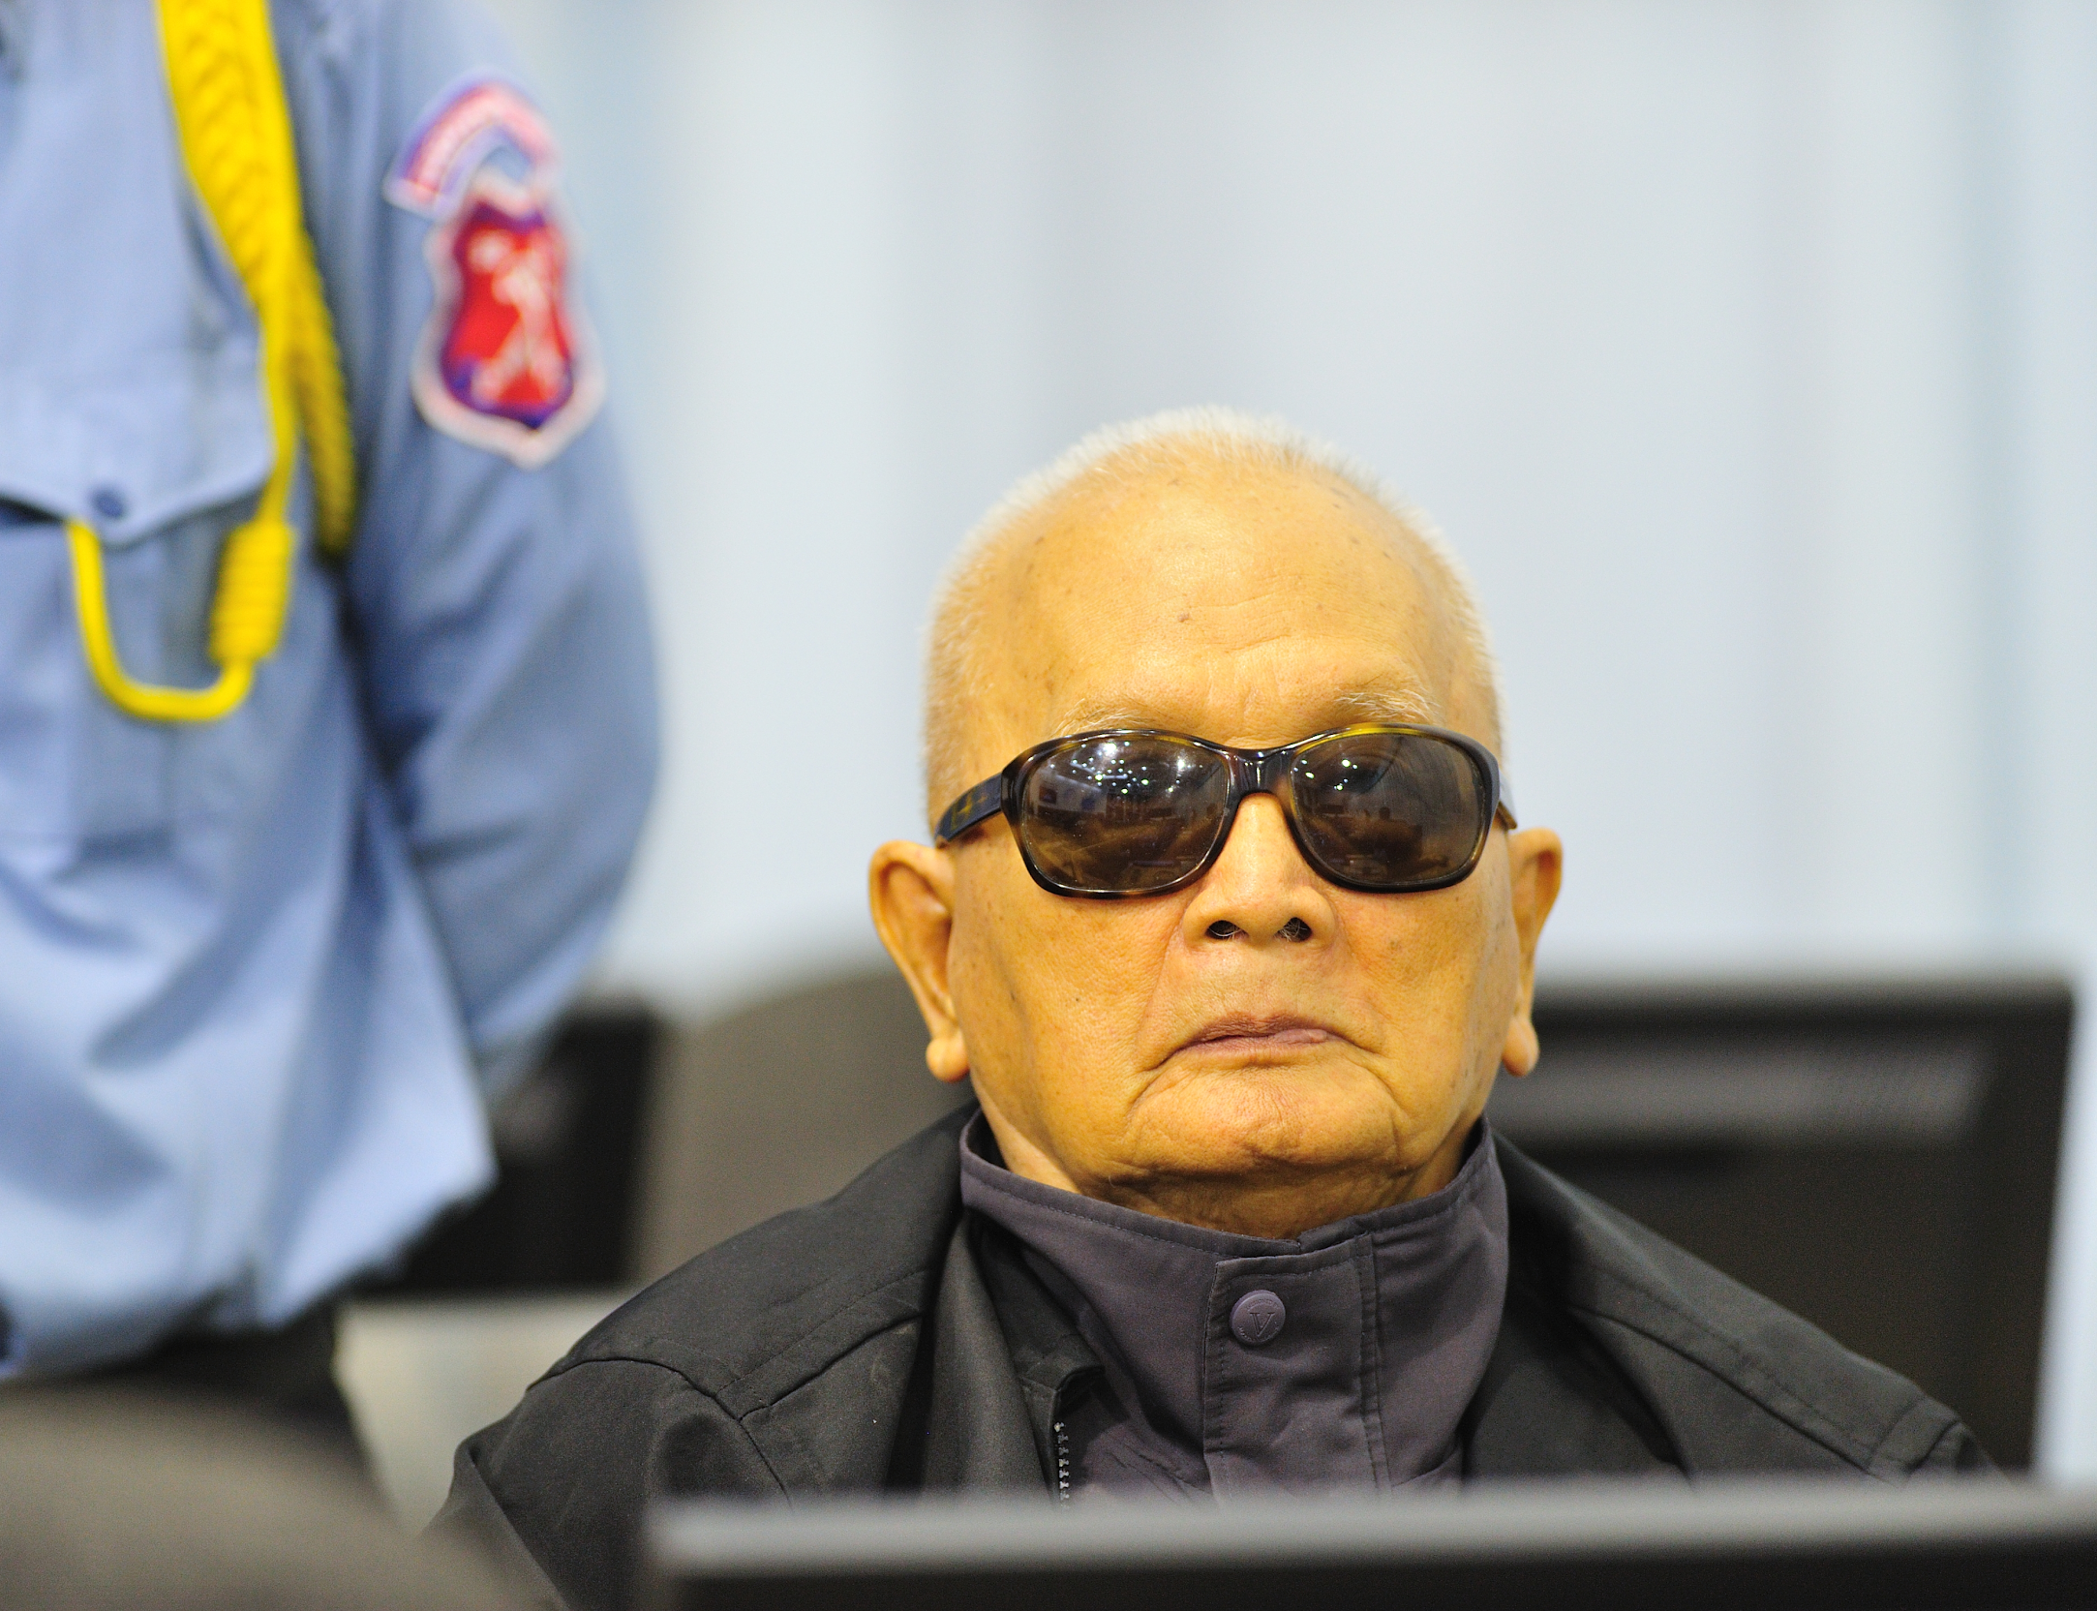
Who have been tried by the ECCC?
Nuon Chea, or Brother Number 2, was tried and sentenced to life imprisonment for crimes against humanity.
Comrade Duch (real name Kaing Guek Eav), was tried and found guilty of crimes against humanity, murder, and torture; he received 30+ years imprisonment (later reduced).

Slide 7
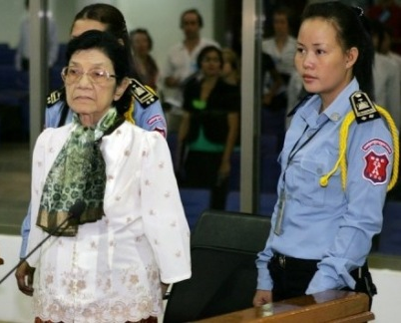
Who have NOT been tried by the ECCC?
Ieng Thirith was found to be too mentally unfit to stand trial (she suffered from Alzheimer’s) and she died in 2015.
Her husband, Ieng Sary, died before the end of his trial.
Pol Pot was, of course, long dead.
The ECCC has been criticized for being too slow and too expensive… do you agree?

Slide 8
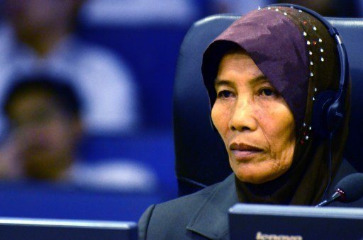
When will the ECCC stop its trials?
In its charter, the ECCC will close its doors once the last possible perpetrator eligible for a trial is dead.
The ECCC has been continuing its work throughout the 2000s, and it is starting to look at the lower-level perpetrators who fit its eligibility requirements...

Slide 9
EXIT TICKET
Answer the following questions, and hand them in before you leave.
What does “ECCC” stand for?
Who are they allowed to bring to trial? (there are two categories!)
Why is the ECCC a mix of Cambodian and UN member judges?
What are the latest ECCC trials about?

