Slide 1
The Cambodian Genocide
Who, What, When, Where, Why, How

Slide 2
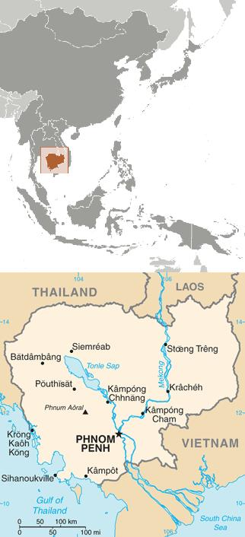
Where:
Cambodia is a small country in southeast Asia, to the west of Vietnam, south of Laos, and east of Thailand. It’s less than half the size of California, and was a colony for over 100 years in the era of European imperialism. It gained its freedom from France in 1953 (like many other countries did after WWII).

Slide 3
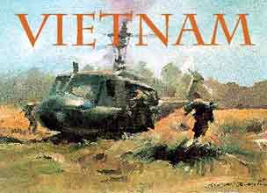
When influences Where:
Cambodia had the misfortune in the 1960s of being too close to Vietnam to escape the effects of the Vietnam War. The hereditary ruler of Cambodia, Norodom Sihanouk, had asserted neutrality while assisting BOTH sides - the Viet Cong secretly used ports and hiding places in Cambodia, while the U.S. was given knowledge of those hiding places and permission to attack.

Slide 4
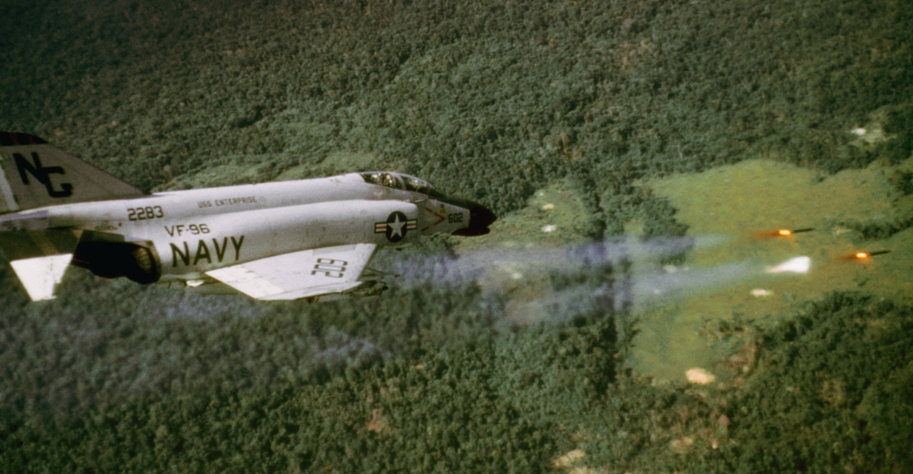
Before the Vietnam War is Over:
Sihanouk is deposed by Lon Nol, one of his own lieutenant-generals and a man backed by the United States, in 1970. Lon Nol is little more than a puppet leader.
Driven into exile, Sihanouk decides to take his loyal soldiers and join forces with the Khmer Rouge, who use this new popular support (many peasants like Sihanouk) to push ahead with a civil war.

Slide 5
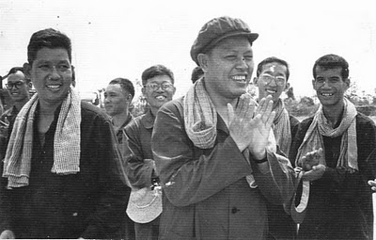
But who are the Khmer Rouge?
Pol Pot was their leader. He was not a peasant - he was educated in France, and admired the various Communist movements of the 20th century. He believed that Cambodia should be recreated, as a country, in the model of the Maoist ideal agrarian society. The clock would be set back to Year “Zero”, with all Western advancements removed, and all citizens would be used in massive farm labor projects. He began recruiting guerrillas long before the Vietnam War, initially to drive out France.

Slide 6
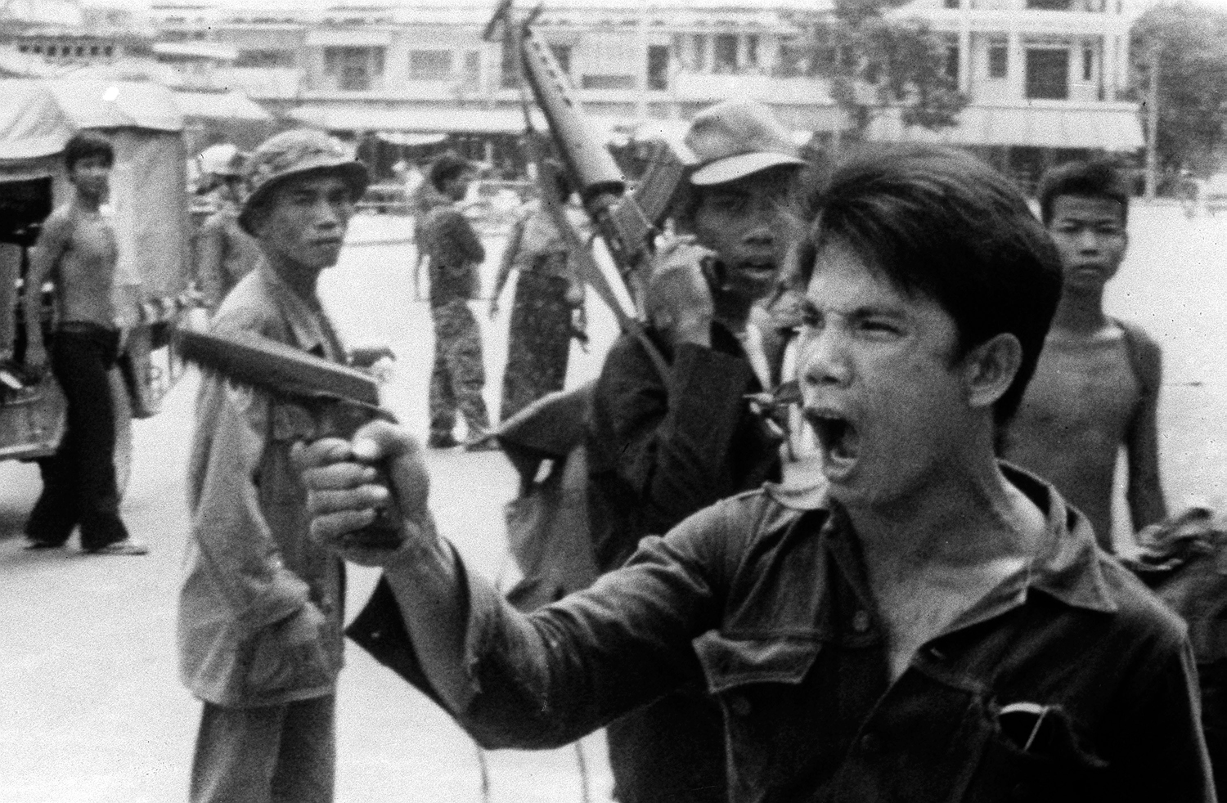
But who are the Khmer Rouge?
The communist movement had some limited popularity in the 1940s, when Cambodians sought to kick out the French.
Pol Pot’s 1960s guerrilla movement started out small, but steadily grew in membership when Cambodians came to resent the U.S. for its bombings and influence on their government. However, the majority of Khmer Rouge soldiers were peasant teenage boys, who bought his message.

Slide 7
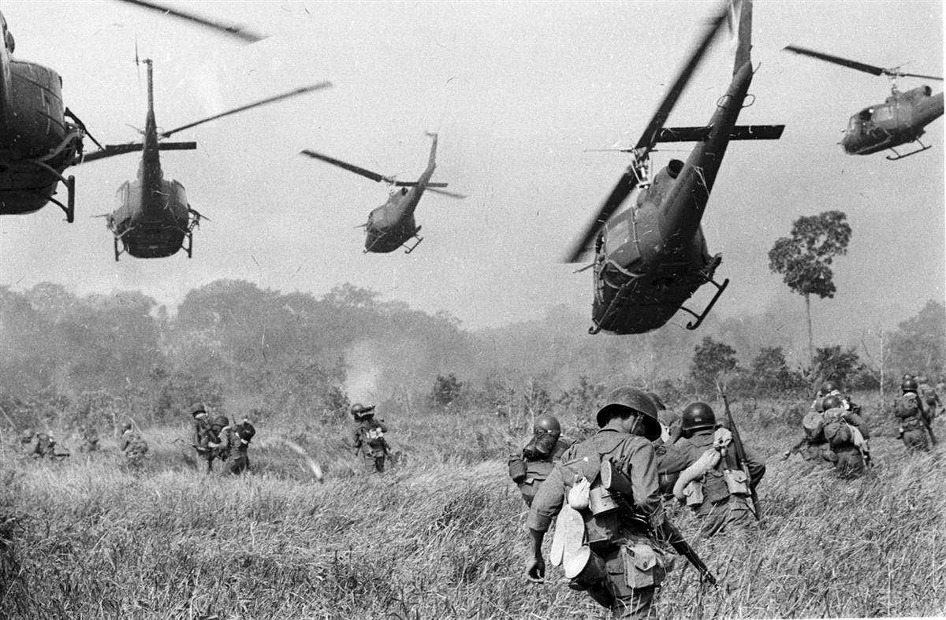
What happened next?
The Cambodian genocide cannot be explained without discussing the various events of Vietnamese and American incursions into Cambodia.
Even though Lon Nol was in power since 1970, and supported the U.S., the U.S. bombed Cambodia extensively in the years leading up to the end of the Vietnam War. Much of American foreign policy can be explained by the “domino theory”.

Slide 8
What happened next?
The Vietnam War ended in 1975, with the U.S. driven out of South Vietnam. At the same time, Pol Pot seized the opportunity to topple Lon Nol from power, and the Kampuchean People’s Revolutionary Party took over Cambodia (soon to be renamed Kampuchea).
The Khmer Rouge lost no time in beginning their plan to reconstruct Cambodia in the image of the agrarian ideal.

Slide 9
Steps taken by the Khmer Rouge:
The program to redesign society included:
Forcibly evacuating the cities and sending everyone to farms
Closing the factories, hospitals, colleges and grade schools
Abolishing currency and private property
Abolishing all political and civil rights
Banning religion
Banning modern technology
Separating children from parents, and sending them to different farms

Slide 10
Steps taken by the Khmer Rouge:
The Khmer Rouge knew that there would be opposition. They therefore attempted to get rid of anyone likely to oppose their program, including:
Intellectuals of all kinds (ex. Doctors, people who were bilingual)
People in possession of technology - this includes things like eyeglasses and wristwatches
Skilled workers

Slide 11
Steps taken by the Khmer Rouge:
The Khmer Rouge also wanted to get rid of people who they felt did not fit into their ideal society. Many of these people were undesirable for the following reasons:
Old, ill and disabled (would not make good workers)
Members of other ethnic groups, especially Vietnamese, Chinese and Thai
Religious - Christians, Muslims and Buddhists all were targeted
Suspected traitors to the cause

Slide 12
Methods used by the Khmer Rouge to exterminate:
The Khmer Rouge had a variety of methods for getting rid of the useless and undesirable.
Execution by gun - used at any time
Forced marches - used when sending people out of cities to the new farms
Forced labor on the farms
Famine - the farms were grossly inadequate even for the decreased population
Prisons, made from the old schools and factories
ONE KHMER MOTTO:
“To spare you is no profit; to destroy you is no loss.”

Slide 13
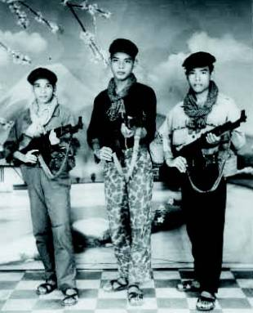
Photo: Young Khmer Rouge soldiers

Slide 14
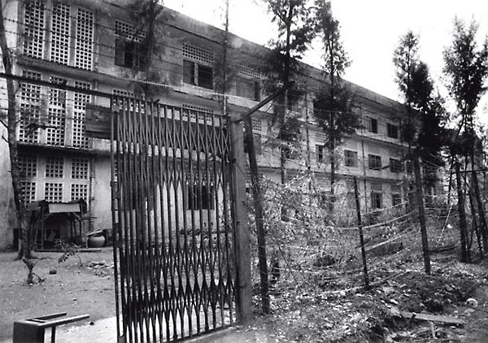
Photo: Tuol Sleng, exterior

Slide 15
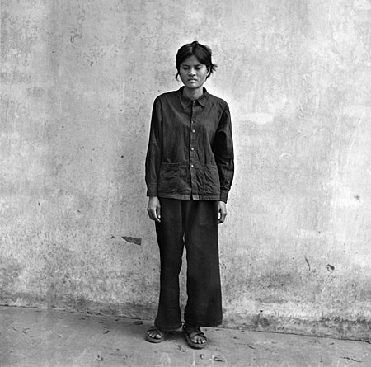
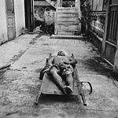
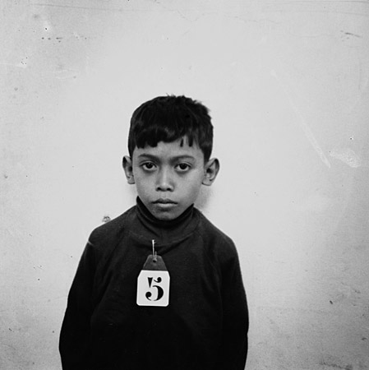
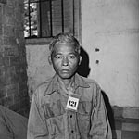
Photo: Tuol Sleng, prisoners

Slide 16
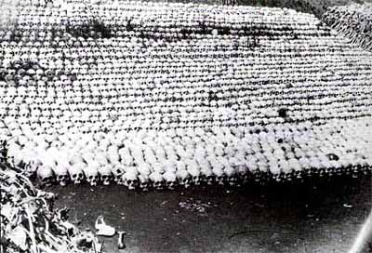
Photo: The Killing Fields

Slide 17
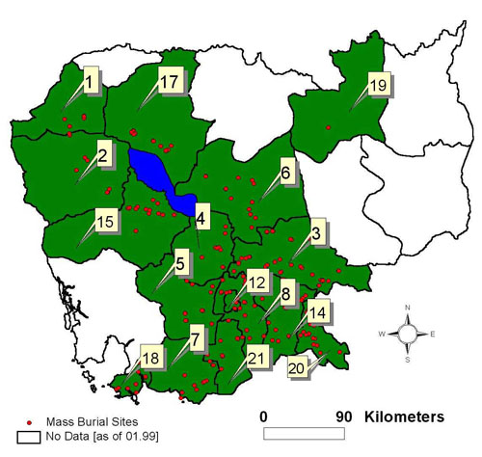
What can we figure out, from this map?
Map: Mass Burial Sites

