Slide 1
The American Response to the Armenian Genocide
The Limits of Aid

Slide 2
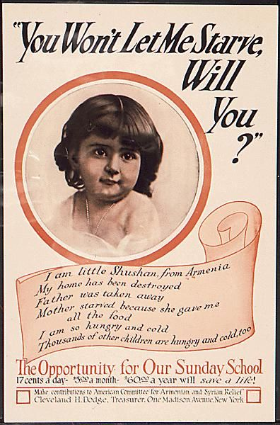
Aid Posters
What imagery is this poster relying on?
What message is this aid organization making - explicitly, and implicitly?

Slide 3
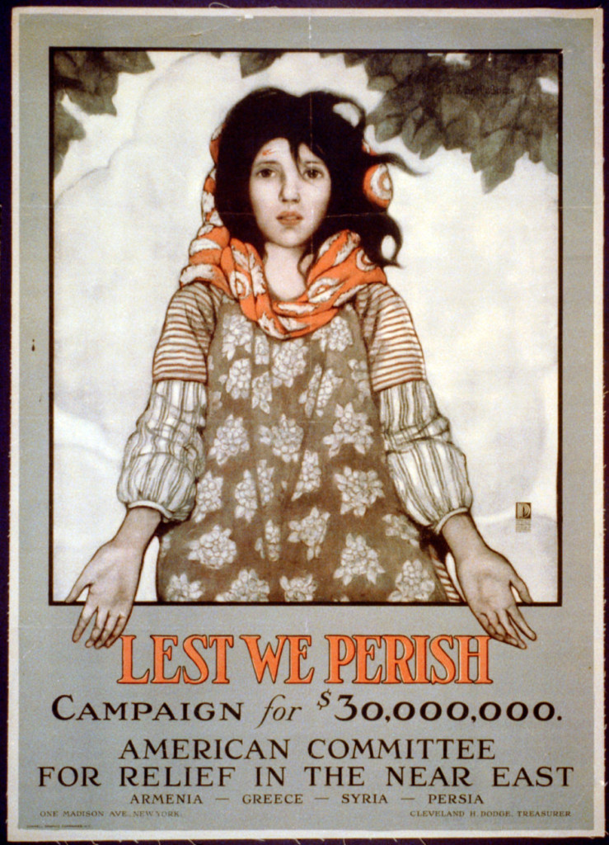
Aid Posters
What imagery is this poster relying on?
What message is this aid organization making - explicitly, and implicitly?

Slide 4
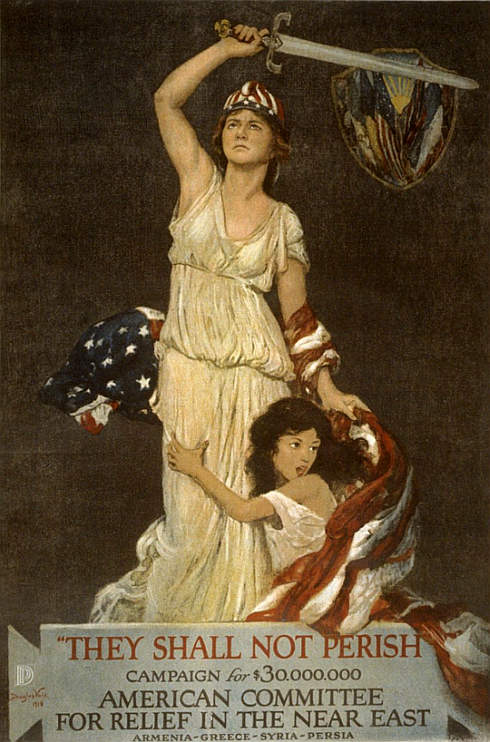
Aid Posters
What imagery is this poster relying on?
What message is this aid organization making - explicitly, and implicitly?

Slide 5
Free-Writing Activity
After WWI, Armenians wanted to have their own country, as a security against persecution. Wilson promoted the idea of “self-determination” - in other words, the idea that groups are able to decide their own future and form their own government.
Respond in your notebooks to the following questions:
Should all groups have the right to form their own governments?
Who should determine if a group should be given their own nation?
Under what conditions, if any, should the U.S. help these groups to form their governments?

Slide 6
Was a New Armenian Nation Practical?
In 1918, what resources did Armenians have to build their own nation?
Photos by John Elder of Armenians after the Genocide:
http://www.armenian-genocide.org/photo_elder.html

Slide 7
Article 22 of the Covenant of the League of Nations:
“Certain communities formerly belonging to the Turkish Empire have reached a stage of development where their existence as independent nations can be provisionally recognized subject to the rendering of administrative advice and assistance by a Mandatory until such time as they are able to stand alone. The wishes of these communities must be a principal consideration in the selection of the Mandatory.”

Slide 8
Brief Debate: should the U.S. accept the Mandate?
In 1919, the United States Congress debated whether or not to accept the League of Nations’ Mandate over Armenia.
The class will split in half. Half of you will come up with arguments for why the U.S. should accept the Mandate, and half of you will come up with arguments for why the U.S. should reject it.
This is a quick thought-exercise, so work together and jot down ideas to share with the whole class in five minutes.

Slide 9
Reading: “A Mandate for Armenia?”
What actually happened:
The US did not accept the UN mandate. The independent Republic of Armenia survived only from 1918-1920. In 1920, the Armenian Republic was swallowed by its more powerful neighbors, Turkey and the Soviet Union. Armenia regained its independence from the Soviet Union in 1991.
Did this surprise you?

Slide 10
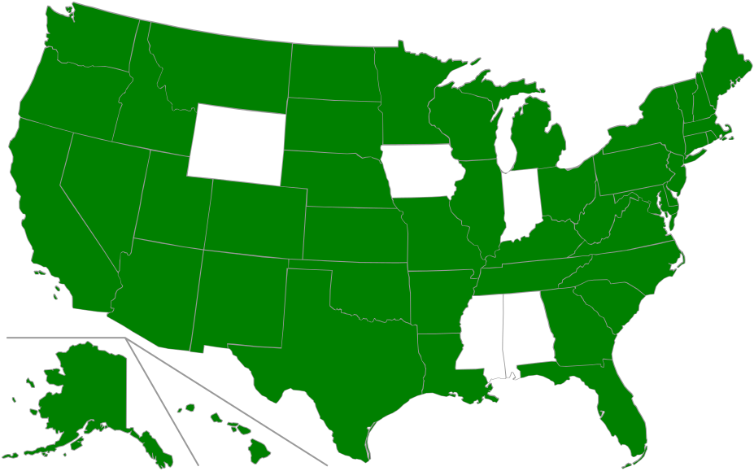
America’s Stance Today:
On a state by state basis: The green-colored states are the ones which have chosen to recognize the Armenian Genocide.
Notes:
By Goran tek-en, CC BY-SA 4.0, https://commons.wikimedia.org/w/index.php?curid=39761945

Slide 11
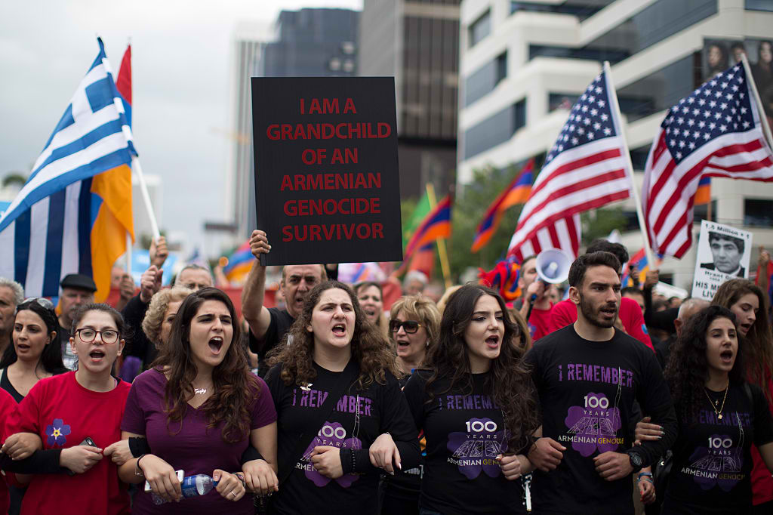
America’s Stance Today:
Starting in the 1970s, the U.S. called it a genocide in some Congressional resolutions.
In 1981, Ronald Reagan called it a genocide.
But today, what is our stance?
Notes:
By Goran tek-en, CC BY-SA 4.0, https://commons.wikimedia.org/w/index.php?curid=39761945

Slide 12
America’s Stance Today:
Barack Obama, January 2008: “As a senator, I strongly support passage of the Armenian Genocide Resolution (H.Res.106 and S.Res.106), and as President I will recognize the Armenian Genocide.”
Barack Obama, in his annual April 24th remembrance speeches, has never called the events of 1914-1915 a genocide.
Why not? He, and his predecessors, do not want to lose the goodwill and cooperation of Turkey, an ally in the Middle East.
Notes:
By Goran tek-en, CC BY-SA 4.0, https://commons.wikimedia.org/w/index.php?curid=39761945

Slide 13
Reading: “Denial, Free Speech and Hate Speech”
Your thoughts:
What is “relativism”?
What is a “false equivalency”?
What First Amendment Rights is Theriault referencing?
Is denying genocide like being an accessory to a crime?
Is genocide denial a form of hate speech?

